Slide 1
A PRESENTATION
ON
BREADTH FIRST SEARCH ALGORITHM
Course Title: Algorithms
Course No.: CSE 2202
SUBMITTED TO
Dr.Anupam Kumar Bairagi
Associate Professor
Computer Science & Engineering Discipline
Khulna University,Khulna
SUBMITTED BY
Mehedi Hasan Shanto
Id:180232
2nd year,2nd term
Computer Science & Engineering Discipline
Khulna University,Khulna
Date: 20 Oct. 2019

Slide 2
Problem:
For a graph of at least 10 nodes, find the result of searching using breadth first search algorithm.
Solution:
Graph traversal means visiting every vertex and edge exactly once in a well-defined order.
BFS is a traversing algorithm where we should start traversing from a selected node (source or starting node) and traverse the graph layer wise thus exploring the neighbour nodes (nodes which are directly connected to source node). We must then move towards the next-level neighbour nodes.
Steps to Solve The Problem:
# Start a breadth-first search at vertex v.
# Visit start vertex and put into a FIFO queue.
# Repeatedly remove a vertex from the queue, visit its unvisited adjacent vertices, put newly visited vertices into the queue.
# Terminate when vertex u is visited or when Q becomes empty (whichever occurs first).

Slide 3
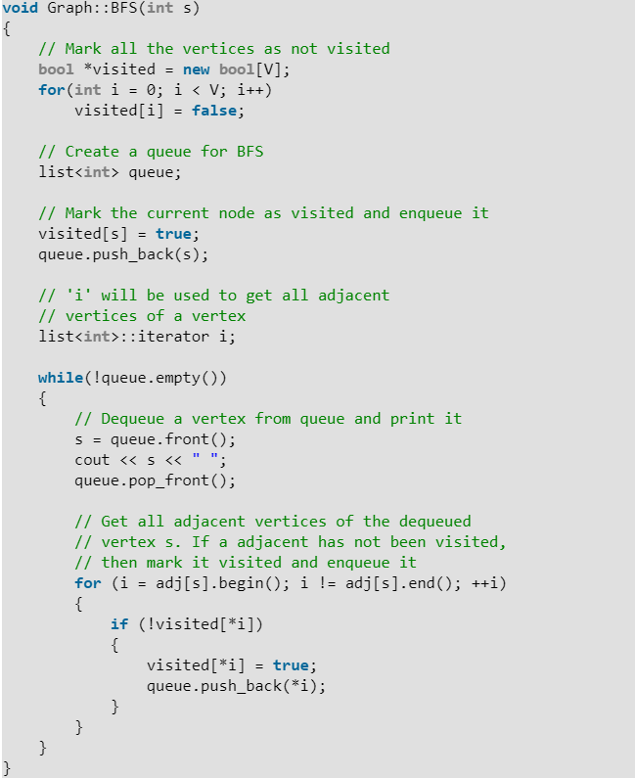
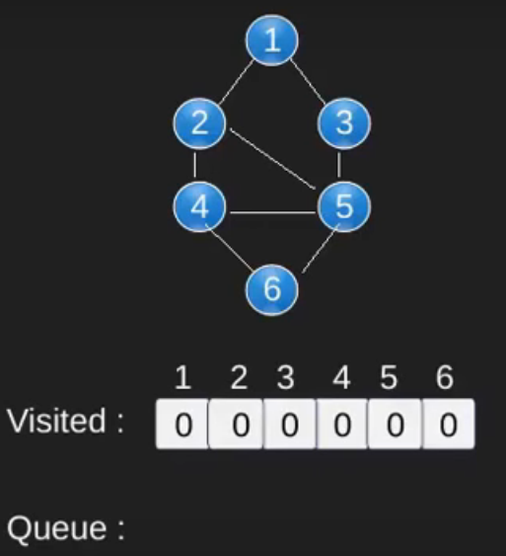
Algorithm & pictorial view

Slide 4
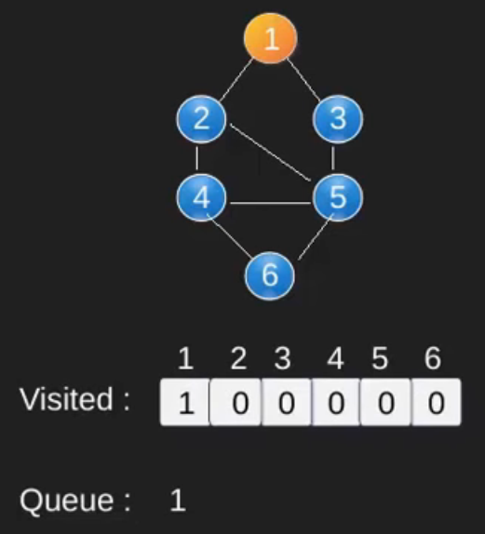
Algorithm & pictorial view

Slide 5
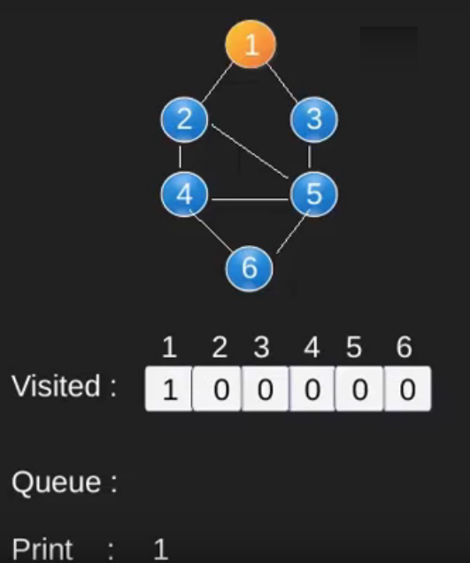
Algorithm & pictorial view

Slide 6
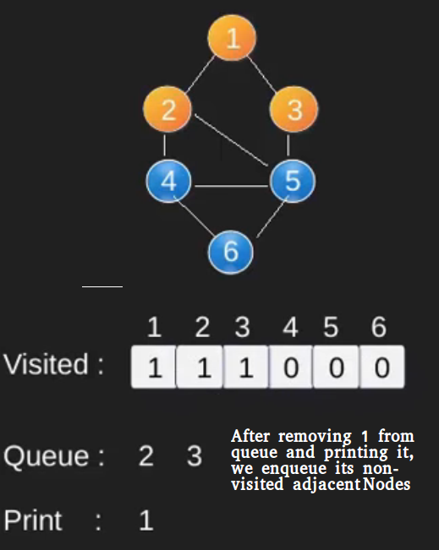
Algorithm & pictorial view

Slide 7
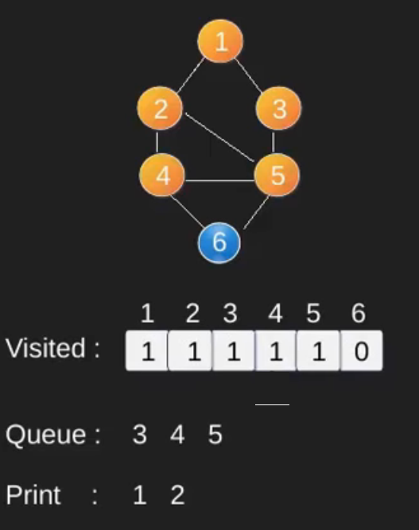
Algorithm & pictorial view

Slide 8
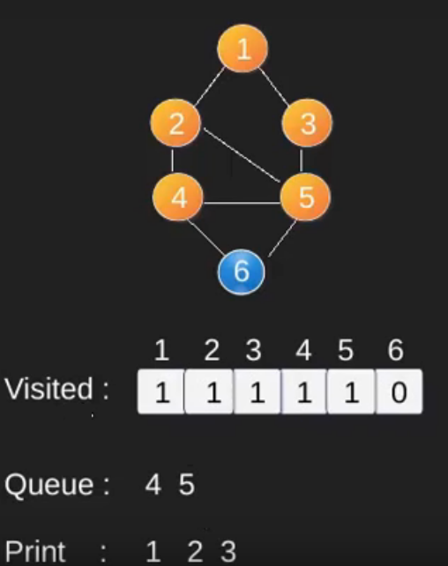
Algorithm & pictorial view

Slide 9
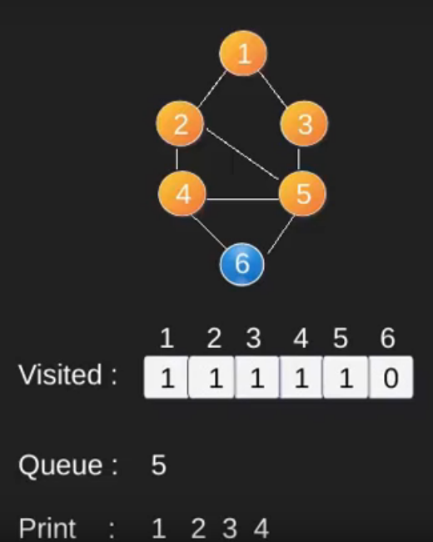
Algorithm & pictorial view

Slide 10
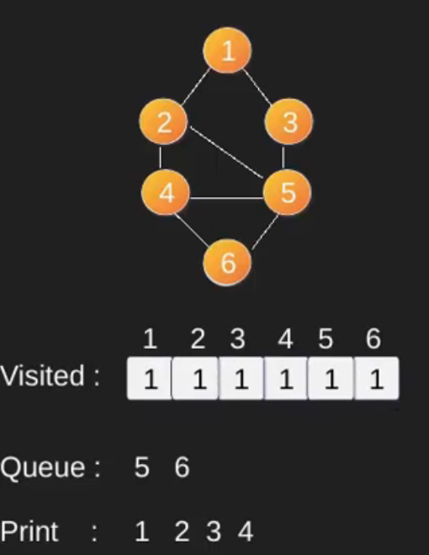
Algorithm & pictorial view

Slide 11
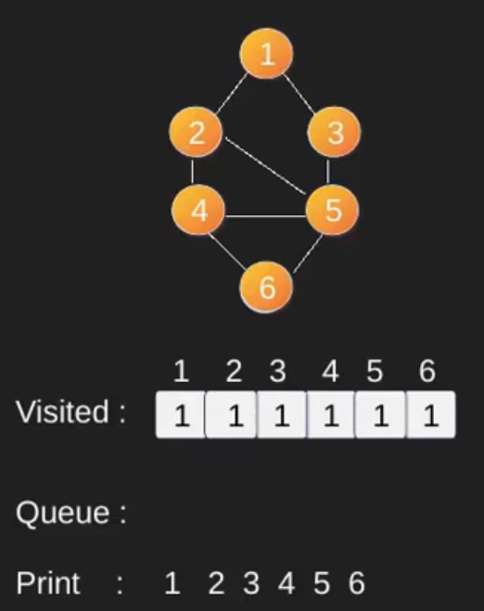
Algorithm & pictorial view

Slide 12
Code:
#include<bits/stdc++.h>
using namespace std;
int visited[10];
int vertex[10][10];
void BFS();
int main()
{
int edge;
cout<<"Enter no of Edges :\n";
cin>>edge;
cout<<"enter nodes:"
int index,j;
for(int i=0; i<edge; i++)
{
cin>>index>>j;
vertex[index][j] = 1;
vertex[j][index] = 1;
}
BFS();
}

Slide 13
void BFS()
{
queue<int> que;
que.push(0);
visited[0] = 1;
while(! que.empty())
{
int v = que.front();
for(int i=0; i<10; i++)
{
if(vertex[v][i] == 1)
if(visited[i] == 0)
{
visited[i] = 1;
que.push(i);
}
}
cout<<v<<" ";
que.pop();
}
}
// if adjacent vertices are visited then push to the queue

Slide 14
INPUT:
Enter no of Edges :
10
Enter Nodes:
0 1
0 3
1 2
1 4
3 4
3 5
4 8
5 6
5 8
6 9
OUTPUT:
0 1 3 2 4 5 8 6 9

Slide 15
Questions ?

Slide 16
Thank You

